Slide 1
Course Name: Database Systems Course Code: CS52 Credits: 3:1:0 UNIT 4 Term: October 2021 – February 2022
M.S. Ramaiah Institute of Technology
(Autonomous Institute, Affiliated to VTU)
Department of Computer Science and Engineering
Faculty:
Dr. Sini Anna Alex

Slide 2
Algorithms for Relational Database Schema Design
Relational Synthesis into 3NF with Dependency Preservation (Relational Synthesis Algorithm)
Input: A universal relation R and a set of functional dependencies F on the attributes of R.
1. Find a minimal cover G for F;
2. For each left-hand-side X of a functional dependency that appears in G,
create a relation schema in D with attributes {X υ {A1} υ {A2} ... υ {Ak}},
where X  A1, X  A2, ..., X  Ak are the only dependencies in G with X as left-hand-side (X is the key of this relation) ;
3. Place any remaining attributes (that have not been placed in any relation) in a single relation schema to ensure the attribute preservation property.
Claim: Every relation schema created by Algorithm is in 3NF.

Slide 3
U(Essn, Pno, Esal, Ephone, Dno, Pname, Plocation)
FD:
Essn→ Esal, Ephone, Dno
Pno→Pname, Plocation
Essn, Pno → Esal, Ephone, Dno, Pname, Plocation
Minimal Cover:
Essn→ Esal, Ephone, Dno
Pno→Pname, Plocation
Decomposed relations:
R1(Essn, Esal, Ephone, Dno)
R2(Pno,Pname, Plocation)

Slide 4
Algorithms for Relational Database Schema Design
Relational Decomposition into BCNF with Lossless (non-additive) join property
Input: A universal relation R and a set of functional dependencies F on the attributes of R.
1. Set D := {R};
2. While there is a relation schema Q in D that is not in BCNF
do {
choose a relation schema Q in D that is not in BCNF;
find a functional dependency X  Y in Q that violates BCNF;
replace Q in D by two relation schemas (Q - Y) and (X υ Y);
};
Assumption: No null values are allowed for the join attributes.
DB(Patno,PatName,appNo,time,doctor)
Patno -> PatName Patno -> Time,doctor Time -> appNo
appNo-> Patno
2NF AND 3NF
DB(Patno,appNo,Time,doctor, PatName)
BCNF
Q=DB(Patno,appNo,Time,doctor, PatName)
Time -> appNo (X→Y, violates BCNF)
Replace Q into: Q-Y AND XUY
D1(Patno,time,doctor, PatName)
D2(Time, appNo)

Slide 5
General Procedure for achieving BCNF when a relation fails BCNF
Let R be the relation not in BCNF, let X be a subset-of R, and let X → A be the FD that causes a violation of BCNF. Then R may be decomposed into two relations:
(i) R –A and (ii) X υ A.
If either R –A or X υ A. is not in BCNF, repeat the process.
Note that the f.d. that violated BCNF in TEACH(Instructor, Student, Course)
was Instructor →Course. Hence its BCNF decomposition would be (TEACH – COURSE) and (Instructor υ Course), which gives
the relations: (Instructor, Student) and (Instructor, Course) that we obtained before in decomposition D3.

Slide 6
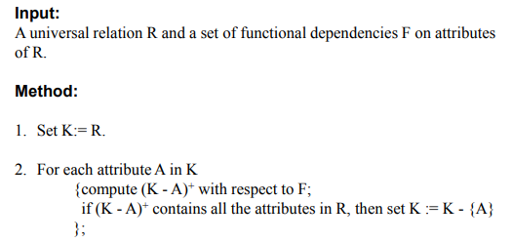
Finding a Key K for R Given a set F of Functional Dependencies
Let R = (A, B, C, D, E) be a relation scheme with the following dependencies-
AB → C
C → D
B → E

Slide 7
Algorithms for Relational Database Schema Design
Relational Synthesis into 3NF with Dependency Preservation and Lossless (Non-Additive) Join Property
Input: A universal relation R and a set of functional dependencies F on the attributes of R.
1. Find a minimal cover G for F.
2. For each left-hand-side X of a functional dependency that appears in G,
create a relation schema in D with attributes {X υ {A1} υ {A2} ... υ {Ak}},
where X  A1, X  A2, ..., X –>Ak are the only dependencies in G with X as left-hand-side (X is the key of this relation).
3. If none of the relation schemas in D contains a key of R, then create one more relation schema in D that contains attributes that form a key of R. (Use Algorithm to find the key of R)
4. Eliminate redundant relations from the resulting set of relations in the relational database schema.

Slide 8
Example
FD:
{P→LCA, LC→AP, A→C}
Minimal Cover: P→LC,LC→AP, A→C
Design X: R1(P,L,C), R2(L,C, A, P) and R3(A,C)
R3 is subsumed by R2, R1 by R2 //eliminating redundant relations
Final Design: R2(L,C,A,P)
F: {P→LCA, LC→AP, A→C}
LC→P , P→A => LC→A
P→A , A→C => P→C
MC:{P→LA, LC→P, A->C}
Alternate Design: S1(P,A,L),S2(L,C,P) AND S3(A,C)

Slide 9
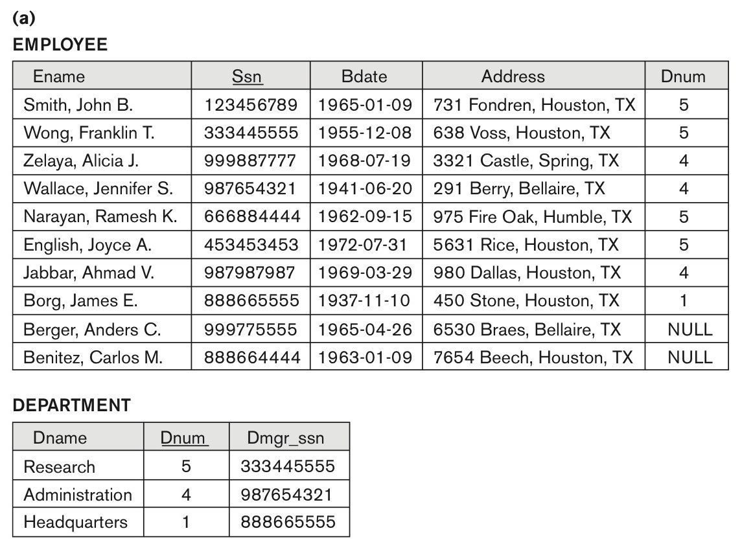
Problems with NULL values and Dangling Tuples
Problems with NULL values
when some tuples have NULL values for attributes that will be used to join individual relations in the decomposition that may lead to incomplete results.
E.g., see Figure 15.2(a), where two relations EMPLOYEE and DEPARTMENT are shown. The last two employee tuples—‘Berger’ and ‘Benitez’—represent newly hired employees who have not yet been assigned to a department (assume that this does not violate any integrity constraints).
If we want to retrieve a list of (Ename, Dname) values for all the employees. If we apply the NATURAL JOIN operation on EMPLOYEE and DEPARTMENT (Figure 15.2(b)), the two aforementioned tuples will not appear in the result.
In such cases, LEFT OUTER JOIN may be used. The result is shown in Figure 15.2 (c).
Figure 15.2
Issues with NULL-value joins. (a) Some EMPLOYEE tuples have NULL for the join attribute Dnum.

Slide 10
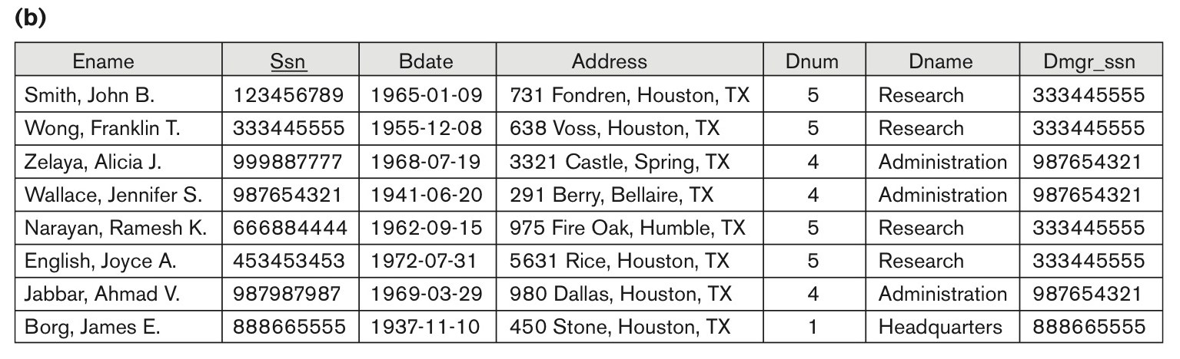
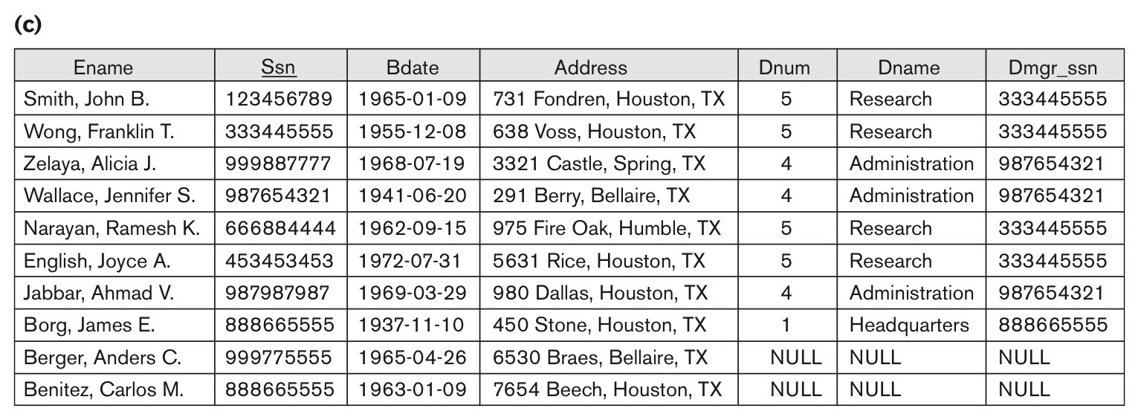
Problems with Null Values and Dangling Tuples
Figure 15.2
Issues with NULL-value joins.
(b) Result of applying NATURAL JOIN to the EMPLOYEE and DEPARTMENT relations.
(c) Result of applying LEFT OUTER JOIN to EMPLOYEE and DEPARTMENT

Slide 11
About Normalization Algorithms
Discussion of Normalization Algorithms:
Problems:
The database designer must first specify all the relevant functional dependencies among the database attributes.
These algorithms are not deterministic in general.
It is not always possible to find a decomposition into relation schemas that preserves dependencies and allows each relation schema in the decomposition to be in BCNF.

Slide 12
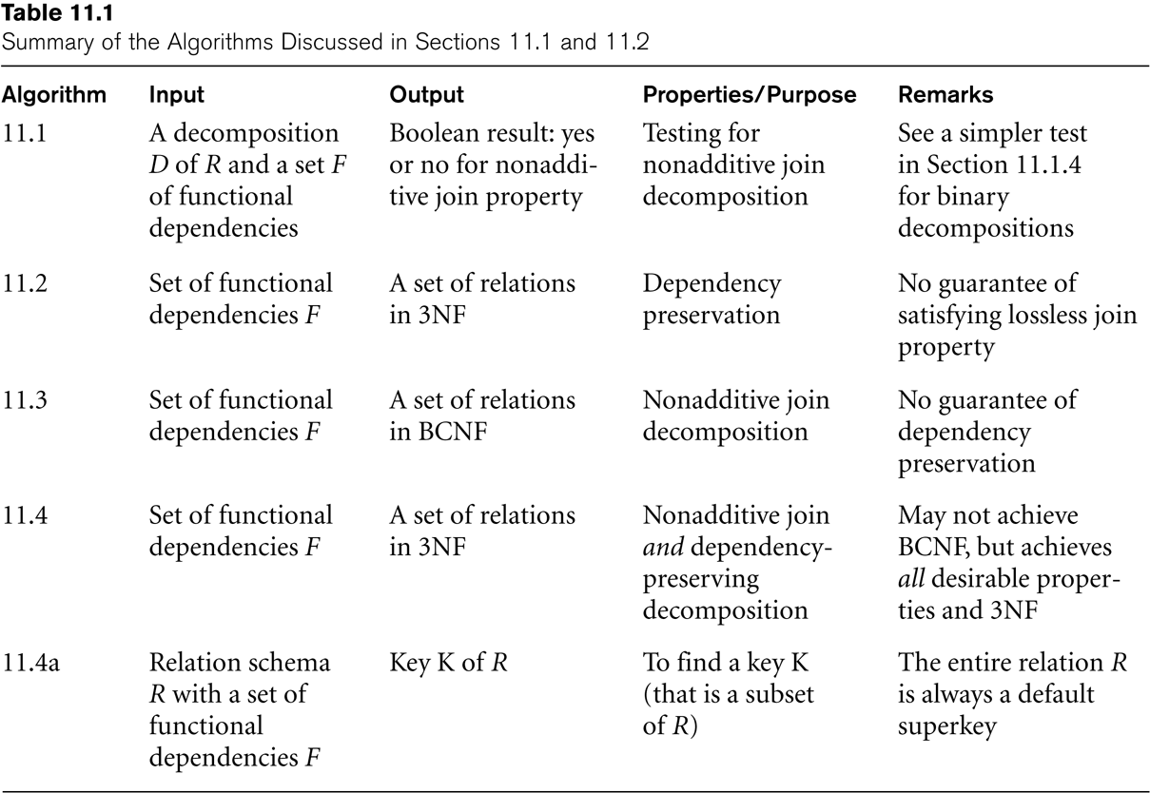
Algorithms for Relational Database Schema Design

Slide 13
Multivalued Dependencies and Fourth Normal Form
Definition:
A multivalued dependency (MVD) X —>> Y specified on relation schema R, where X and Y are both subsets of R, specifies the following constraint on any relation state r of R: If two tuples t₁ and t₂ exist in r such that t₁[X] = t₂[X], then two tuples t₃ and t₄ should also exist in r with the following properties, where we use Z to denote (R 2 (X υ Y)):
t₃[X] = t₄[X] = t₁[X] = t₂[X].
t₃[Y] = t₁[Y] and t₄[Y] = t₂[Y].
t₃[Z] = t₂[Z] and t₄[Z] = t₁[Z].
An MVD X —>> Y in R is called a trivial MVD if (a) Y is a subset of X, or (b) X υ Y = R.

Slide 14
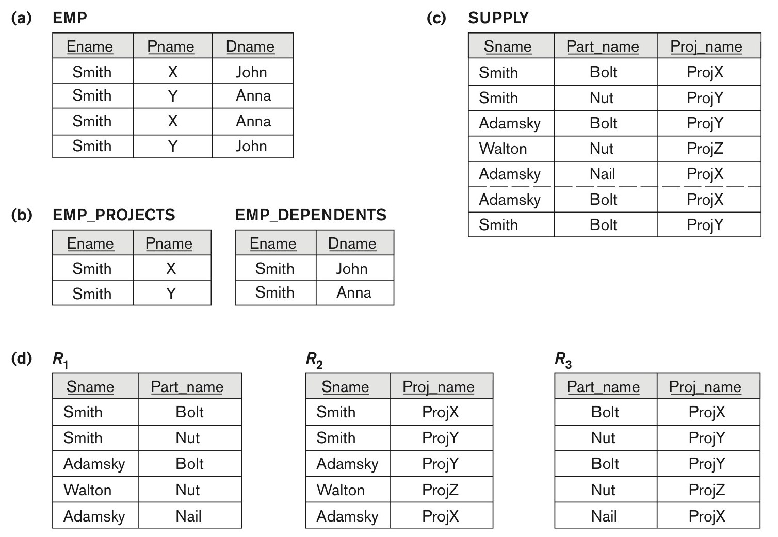
Fourth normal forms
Fourth normal forms. (a) The EMP relation with two MVDs: Ename –>> Pname and Ename –>> Dname. (b) Decomposing the EMP relation into two 4NF relations EMP_PROJECTS and EMP_DEPENDENTS. (c) The relation SUPPLY with no MVDs is in 4NF but not in 5NF if it has the JD(R1, R2, R3). (d) Decomposing the relation SUPPLY into the 5NF relations R1, R2, R3.

Slide 15
Multivalued Dependencies and Fourth Normal Form
Definition:
A relation schema R is in 4NF with respect to a set of dependencies F (that includes functional dependencies and multivalued dependencies) if, for every nontrivial multivalued dependency X —>> Y in F⁺, X is a superkey for R.
Note: F⁺ is the (complete) set of all dependencies (functional or multivalued) that will hold in every relation state r of R that satisfies F. It is also called the closure of F.

Slide 16
Thank you

